Slide 1

Design and development of Travel Guide using Wikipedia text
Under the guidance of –
Mr. Sagar Patil
Mr. Sudhanshu Trivedi
Internal guide-
Dr. Anju S.Pillai
Assistant Professor (SG)
EEE Department
Amrita Vishwa Vidyapeetham,
Coimbatore.
By-
Mrs. Sejal Badgujar
MTech, II year ,2018-20
EEE Department
Amrita Vishwa Vidyapeetham,
Coimbatore

Slide 2
Overview
Introduction
Objective
System Overview
Methodology
Work done
Conclusion
References

Slide 3
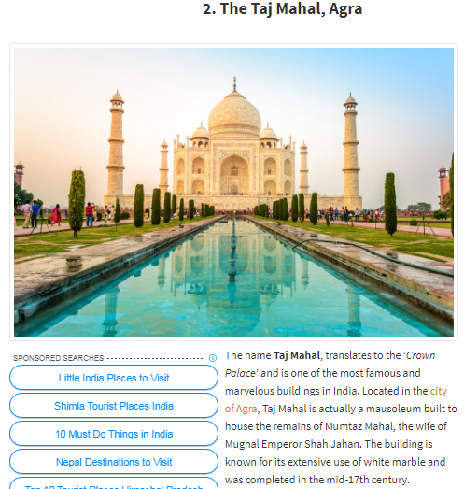
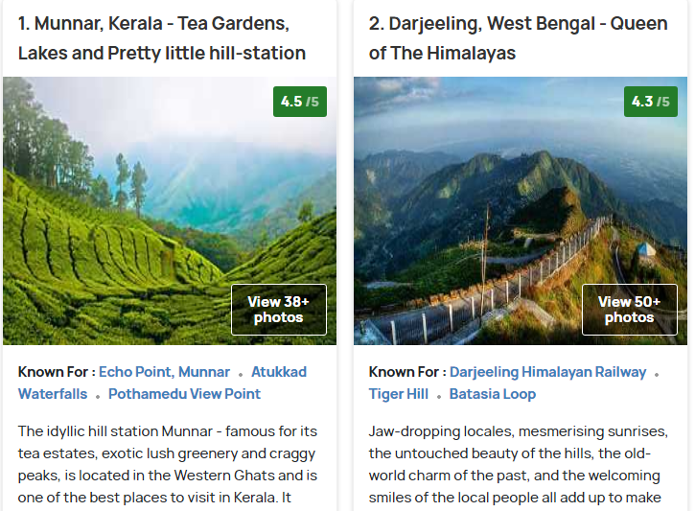
Introduction
Wikipedia contains details of each and every place
https://www.holidify.com/collections/tourist-places-in-india
http://www.transindiatravels.com/india/best-places-to-visit-in-india/
Source: Google
Notes:
Even though many sites are available, none of them gives details in every aspects. We need to browse through diffferent sites to get details. Need google maps to find nearbby places and need zomato to see what are fomous food available. We oftern go to wikipedia for hitorical information and details or for travel routes and all. If such details are provided at single place, tourists will e happier as they will not be in need of guide anymore. Because this site or app will guide them just like human guide.

Slide 4
Objective
To design and develop a Travel Guide with the help of Wikipedia data using topic modeling and machine learning algorithms.

Slide 5
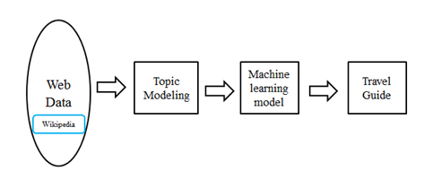
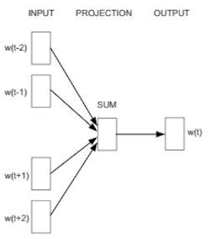
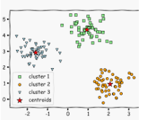


System Overview

Slide 6

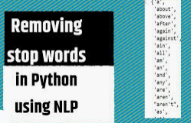
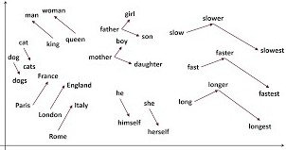
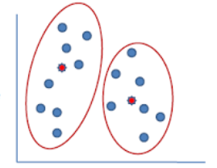
Methodology
Data Acquisition
Data Filtering
Word embedding
Clustering Algorithms
Complete travel book

Slide 7
Software Requirements
Python IDLE
Jupyter notebook

Slide 8
Work Done
Data acquisition - Data is fetched from Wikipedia and stored in text file for a sample Wikipedia page (e.g. Sinhagad)
Data filtering- Stop words which are not useful are removed.
Introduction to Jupyter notebook is done.
Ideal output epected from the data is created manually as output csv file creation.
Study of word emedding, word2vec, fetaure extraction.

Slide 9
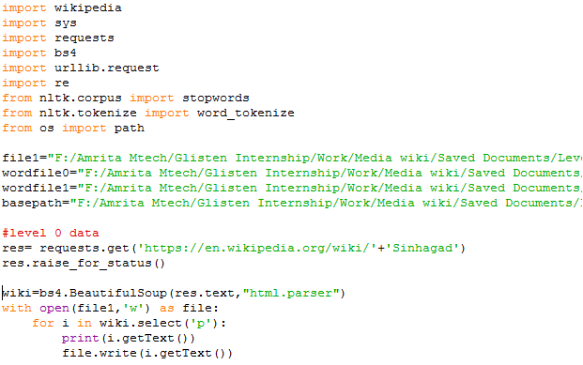
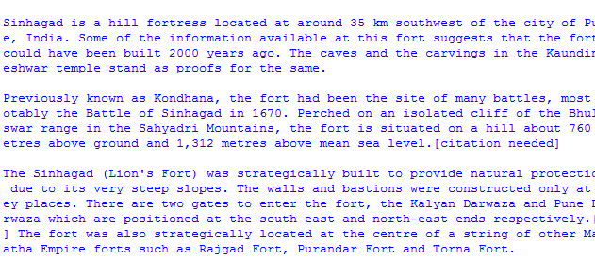
Results

Slide 10
Conclusion
Data fetching and filtering is done for sample site as Sinhagad fort.
Work to be done:
Study and creation of word vector for sample data.

Slide 11
References
George Forman, Evan Kirshenbaum “Extremely Fast Text Feature Extraction for Classification and Indexing”, HP Laboratories, HPL-2008
Hong Liang, Xiao Sun, Yunlei Sun and Yuan Gao,” Text feature extraction based on deep learning: a review”, Liang et al. EURASIP Journal on Wireless Communications and Networking, 2017

Slide 12


